Slide 1
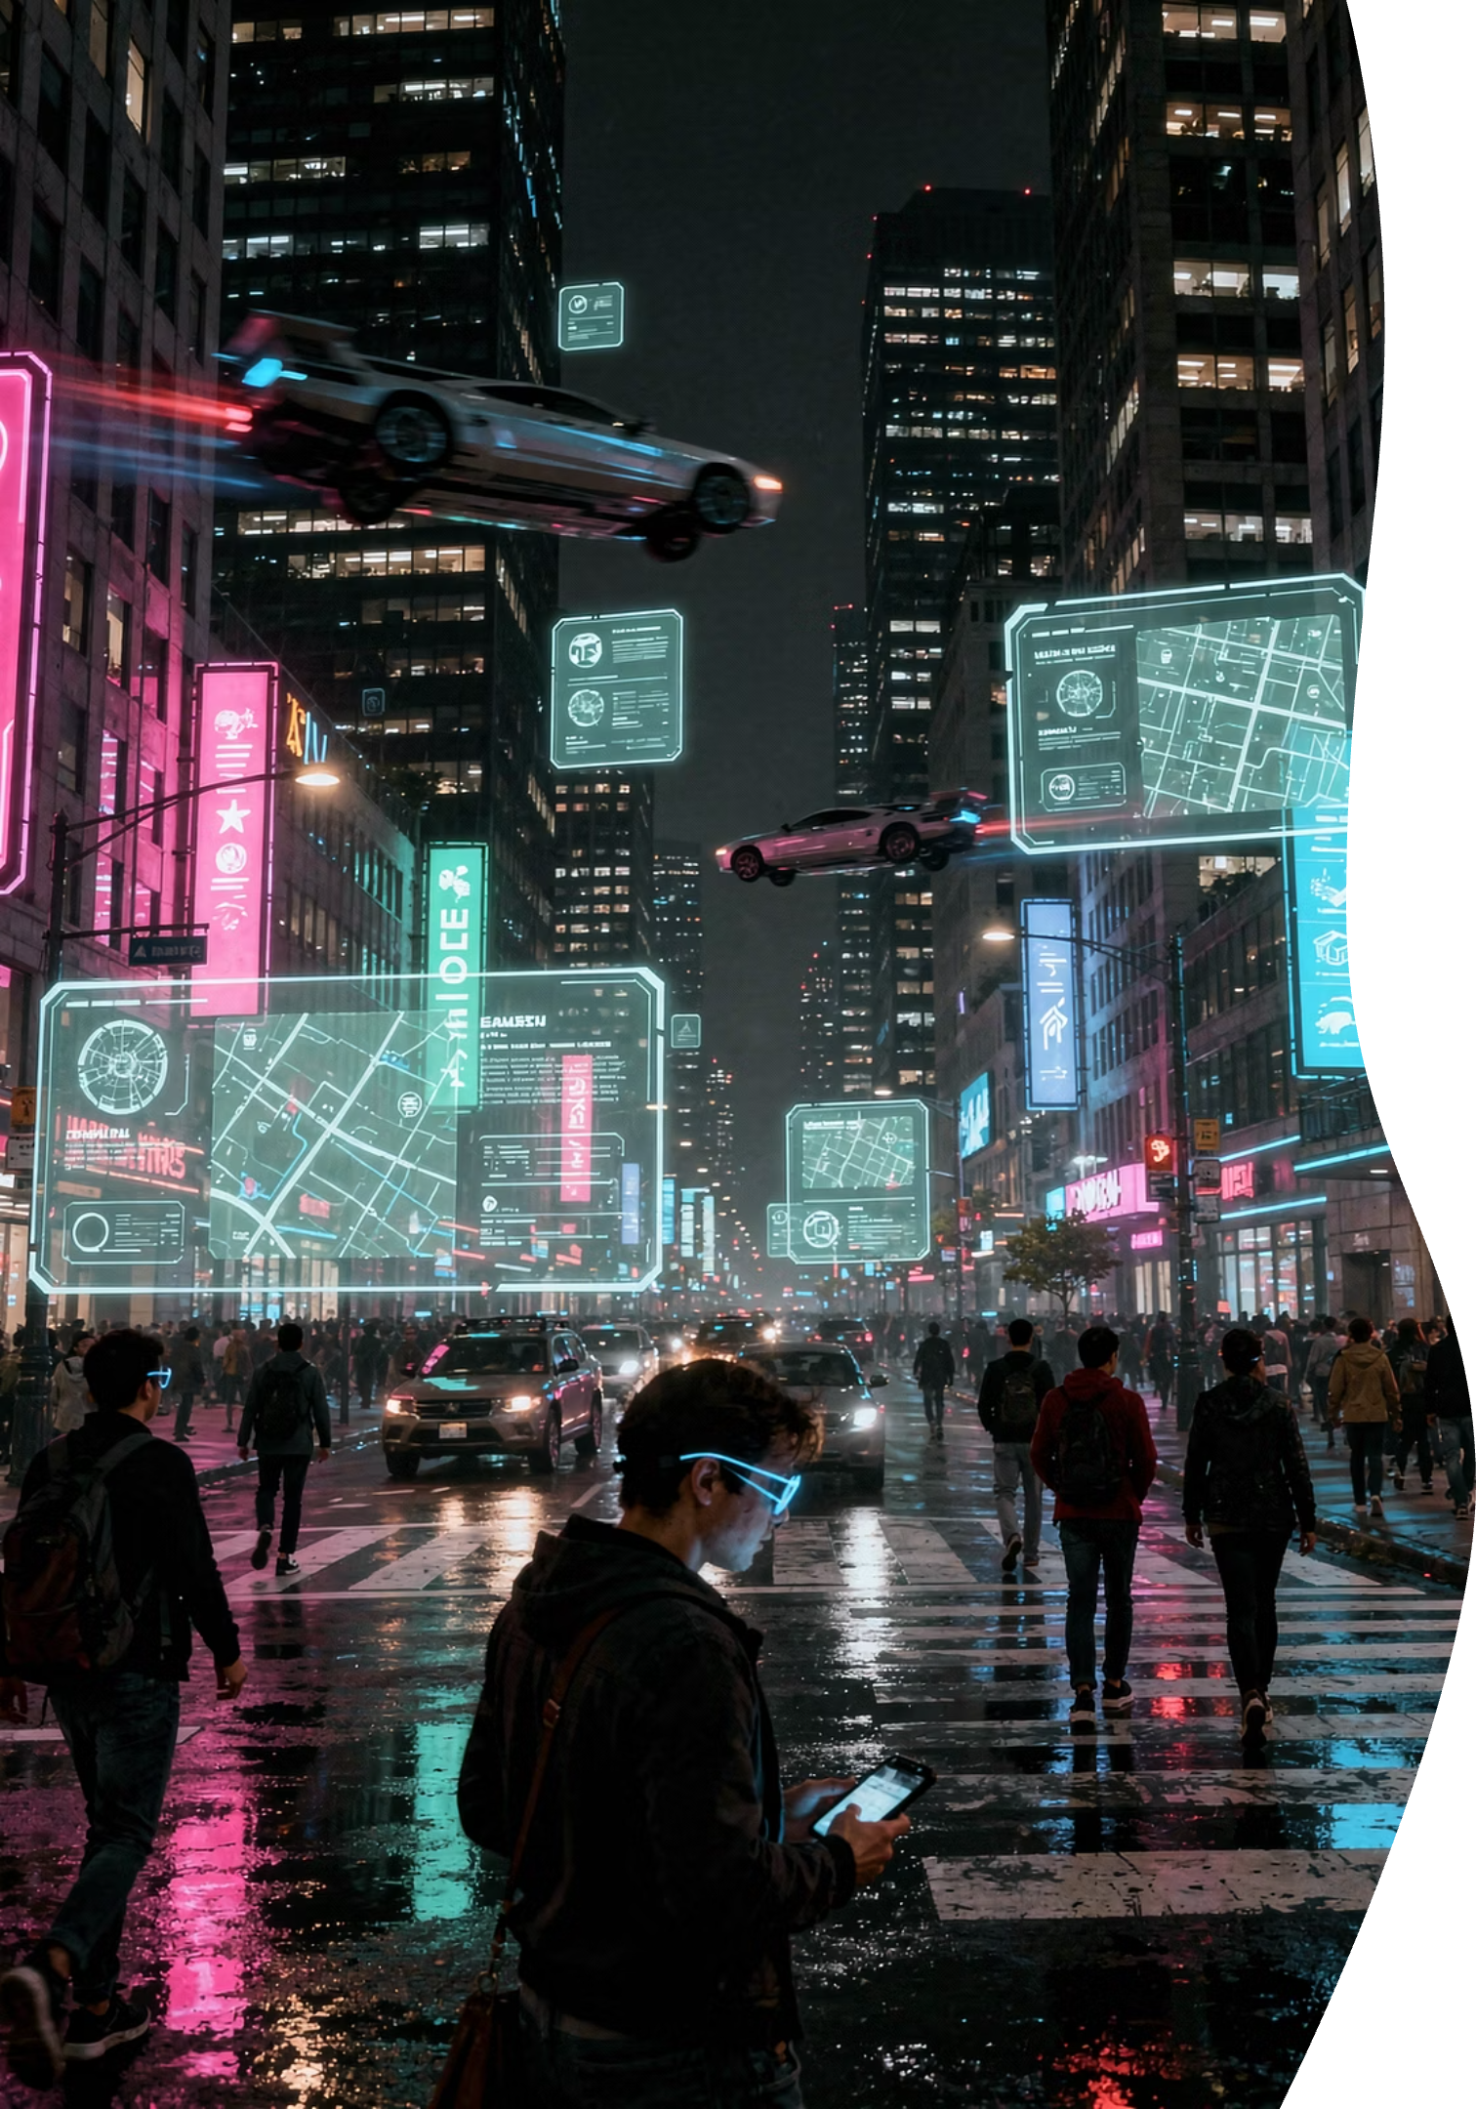
1 The Reality Check
AR + AI Foundations

Slide 2




CORE CONCEPT
What "Augmented" Actually Means
Adding digital information on top of what you already see
Real World
Digital Layer
AR Result
What your camera sees
Graphics, text, 3D objects
Combined experience
You've Already Used AR
Instagram Filters
Snapchat Lenses
Google Maps
Face effects in real-time
Animated face tracking
Live navigation arrows

Slide 3
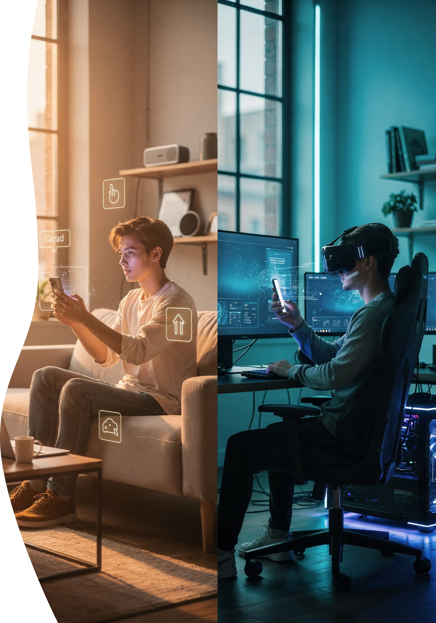

CRITICAL DIFFERENCE
AR vs VR: Clear the Confusion
AR = Adds to Reality
VR = Replaces Reality
✅ See the real world
❌ Fully virtual world
✅ Digital content overlaid
❌ Headsets required
✅ Stay grounded in reality
❌ Complete immersion
This Workshop ✓
Not Covered ✗
Important: We're NOT teaching VR. No headsets, no game engines, no virtual simulations.

Slide 4
THE PIPELINE
How AR Actually Works
It's a process, not magic
01
02
03
Camera Captures
Software Processes
Output Displays
Real-world frames captured every millisecond
AI analyzes and interprets the visual data
Enhanced view shown on your screen
The software sits in between—that's where the intelligence lives

Slide 5
THE INTELLIGENCE LAYER
Why AR Needs AI
Cameras capture pixels—AI gives them meaning
Camera Alone
AI Processing
Smart AR
Just pixels and colors
Recognizes patterns
Tracks and responds
No understanding
Detects features
Anchors content
AI Makes AR Intelligent
Face Detection
Hand Tracking
Object Recognition
Finds and tracks facial features in real-time
Recognizes gestures and finger positions
Identifies and follows real-world items

Slide 6
BEHIND THE SCENES
AR = Math + Camera
(But You Don't Need to Fear It)
Math Handles
You Don't Write It
X, Y coordinates
Libraries do the heavy lifting
Positions in space
Pre-built functions handle all calculations
Size calculations
You just call simple commands
Movement tracking
Think of it like GPS: Complex math underneath, simple to use on top

Slide 7

YOUR TOOL
Why Python for AR + AI
The practical choice, not just hype
The Glue Language
Connects camera, AI models, and display seamlessly
AI Powerhouse
Massive libraries: OpenCV, MediaPipe, TensorFlow
Easy to Learn
Clear syntax, readable code, fast prototyping
Industry Standard
Used in AI research, computer vision, automation

Slide 8
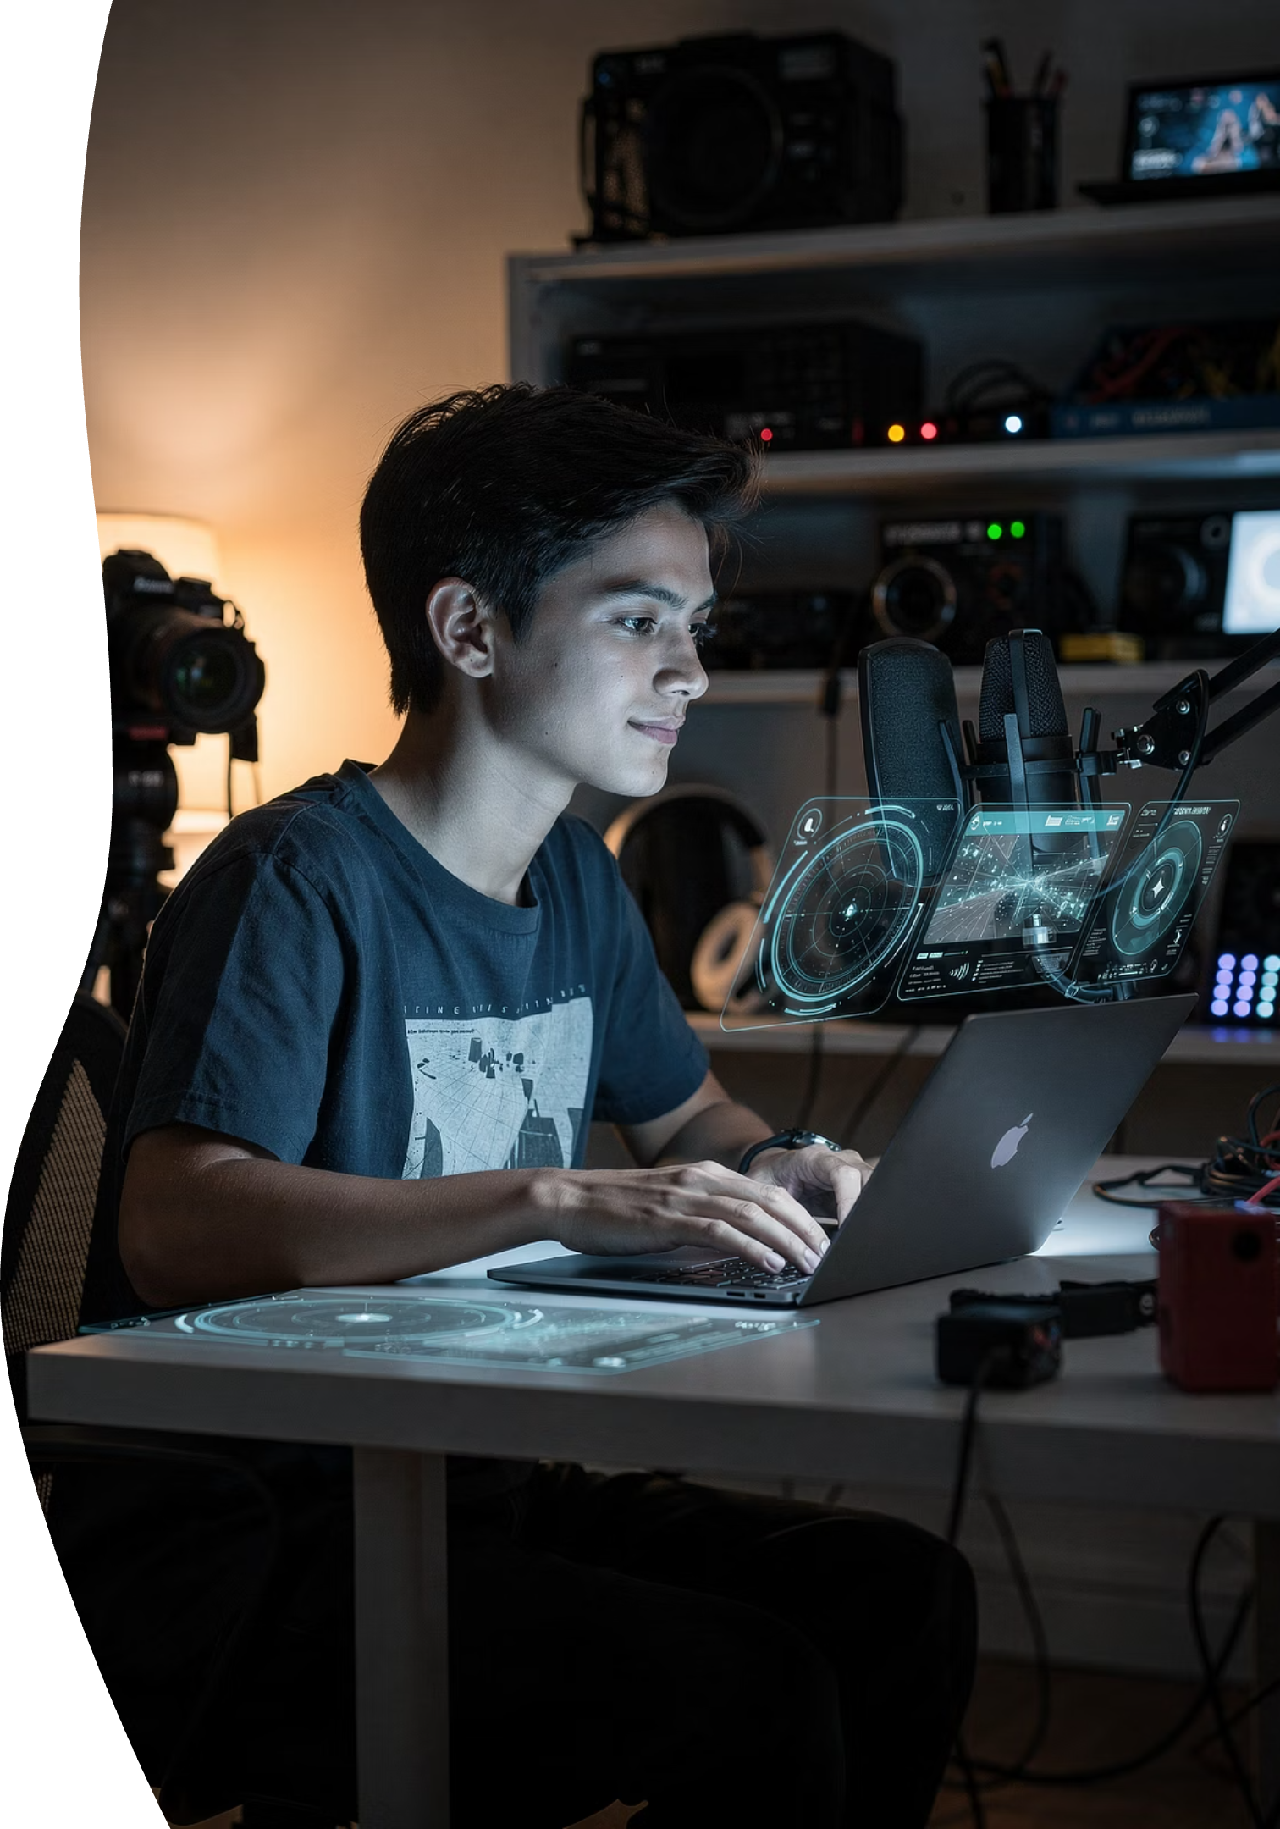
REALISTIC GOALS
What You'll Actually Build
Setting honest expectations
✓ You CAN Do
○ Future Skills
Camera-based AI logic
AAA-level AR apps
Process live video feeds
Requires advanced frameworks
Face tracking systems
Metaverse platforms
Detect and follow facial features
Needs 3D engines and servers
Hand gesture recognition
Wearable AR devices
Build interactive controls
Specialized hardware development
Simple AR overlays
Multi-user AR spaces
Add graphics to real-world views
Complex networking required
Master the fundamentals first—everything else builds on this foundation

